Slide 1
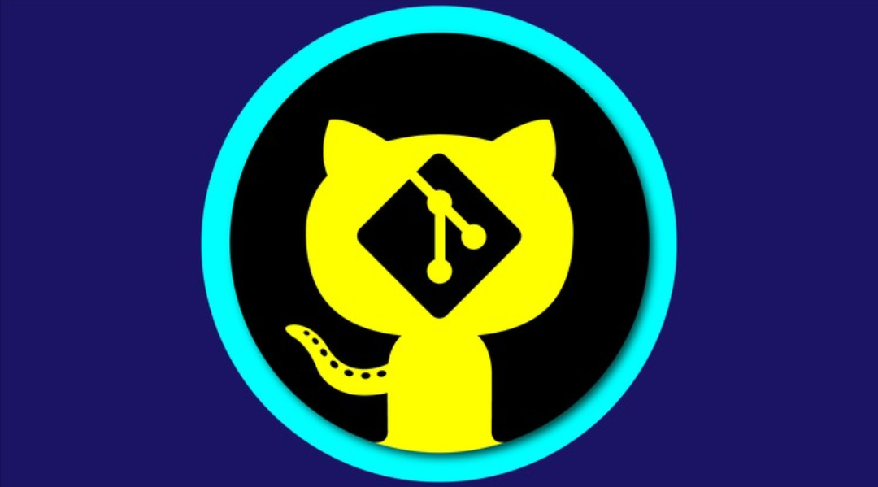
GIT/GITHUB OR FUTURE VIRTUAL LIBRARY/OFFICE
Introducing Of GIT/GITHUB

Slide 2
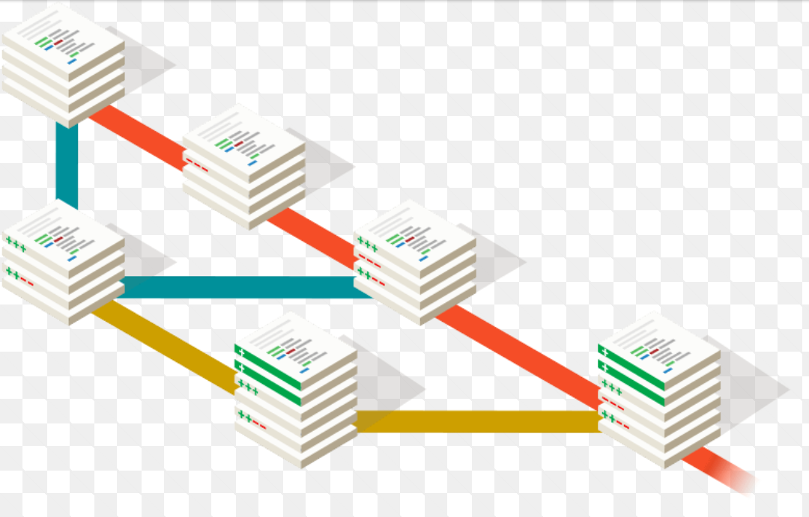
What is GIT?
GIT is a free and open source distributed version control system designed to handle everything from small to very large projects with speed and efficiency.It is easy to learn and has a tiny footprint with lightning fast performance.It outclasses SCM tools like Subversion, CVS,Perforce,and ClearCase with features like cheap local branching,convenient staging areas and multiple workflows. Moreover, it is a version control system for tracking changes in computer files and coordinating work on those files among multiple people.it is primarily used for source code management in software development,but it can be used to keep track of changes in any set of file. As a distributed revision control system,it is aimed at speed,data integrity, and support for distributed, non-linear workflows. GitHub, TortoiseGit, GitLab,Git-annex are platforms of Git.
As with most other distributed version control systems and unlike most client-server systems every.Git directory on every computer is a full-fledged repository with complete history and full version tracking abilities,independent of network access or a central server .
Source Code Management System

Slide 3
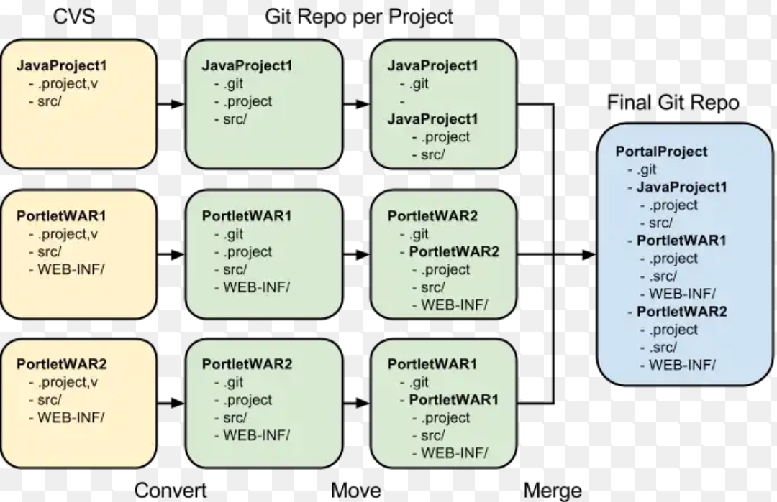
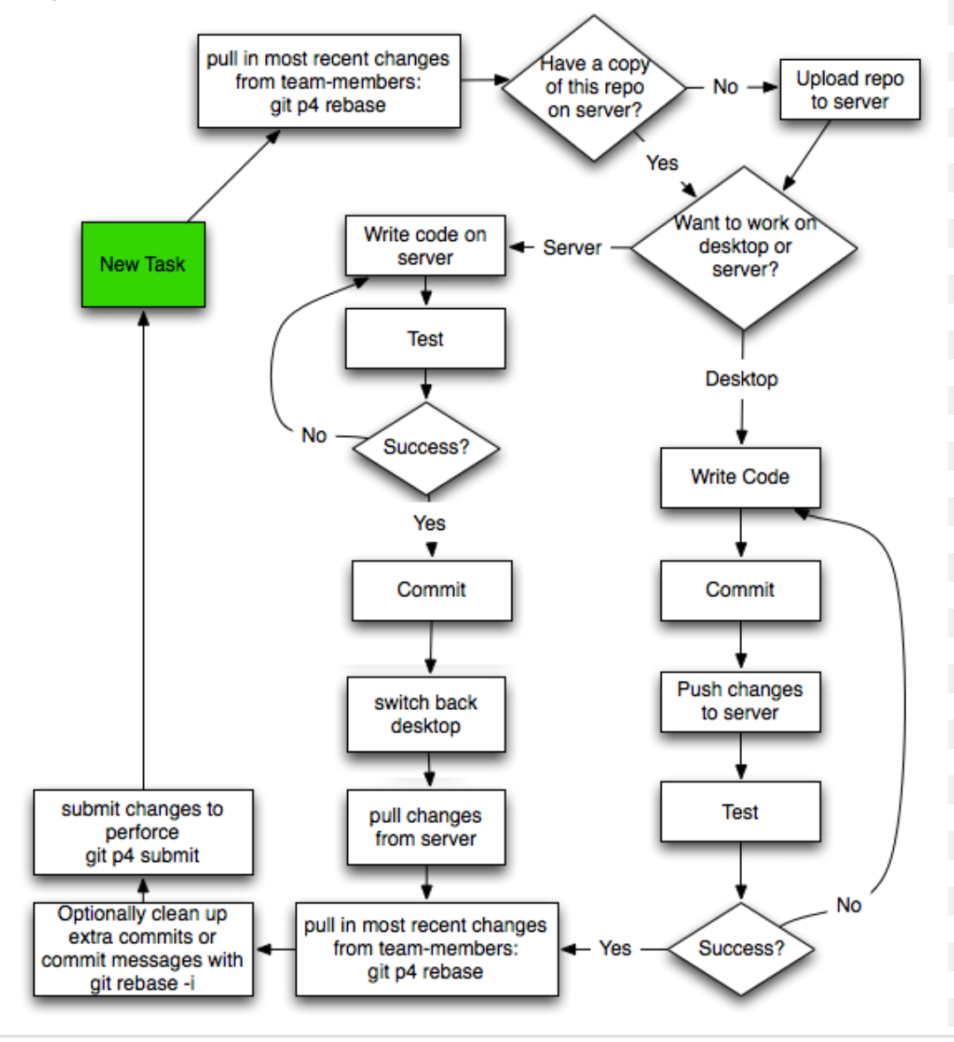
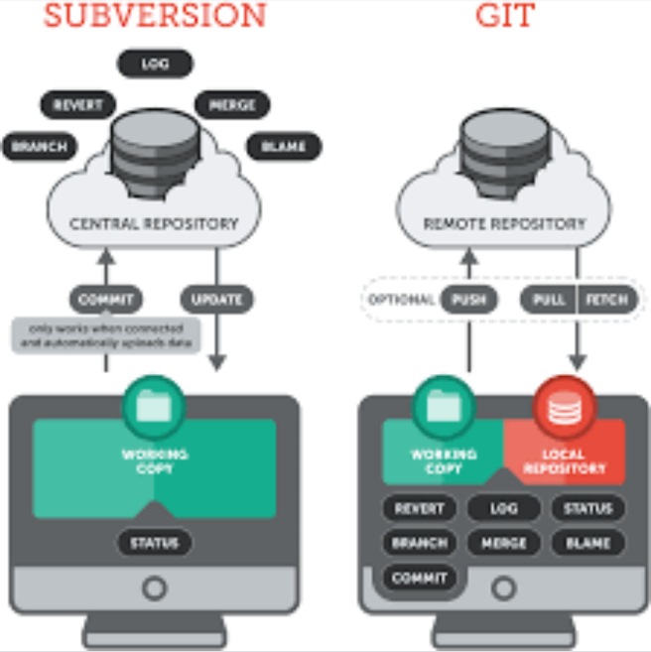
Migrate from CVS to GIT
GIT-Perforce Usage Diagram
Switching From Subversion To GIT

Slide 4
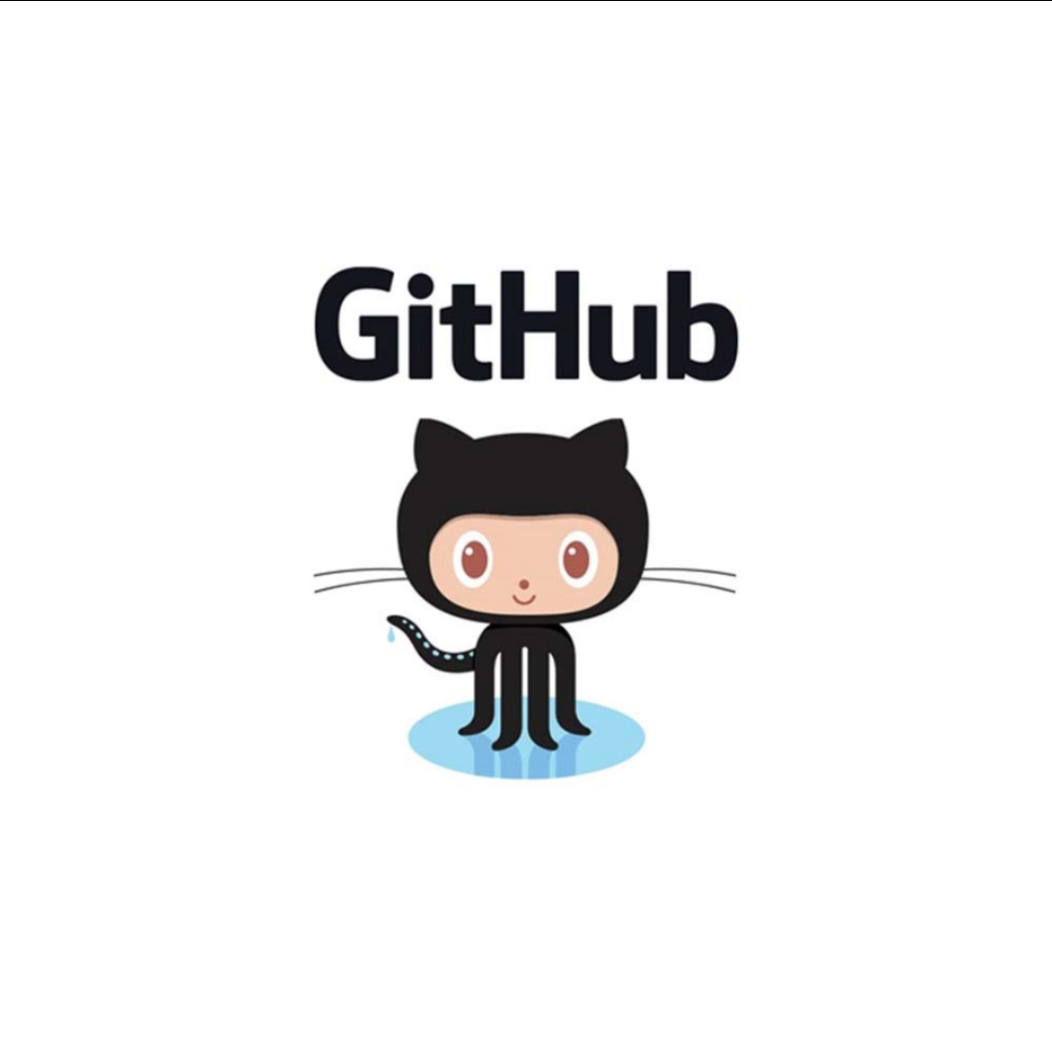
What is GitHub?
GitHub is a web-based hosting service for version control using Git.It is mostly used for computer code.It offers all of the distributed version control and source code management(SCM) functionality of Git as well as adding its own features.GitHub allows you to share your repositories with others.Access other user’s repositories (GitHub server) as backup of your local copies. Atom, Electron,Developer API are platform of GitHub.
GitHub is online product or online repository which uses git technology for the processes and achieve version controls along with other functionalities like bug tracking,Project management,Support ticket management …etc . In other words GitHub is wrapper build on git technology with a UI and other functionality by other third party firm,it is actually a product owned by somebody or some group based on git technology,where as git is open sourcer,and not marketable product.

Slide 5
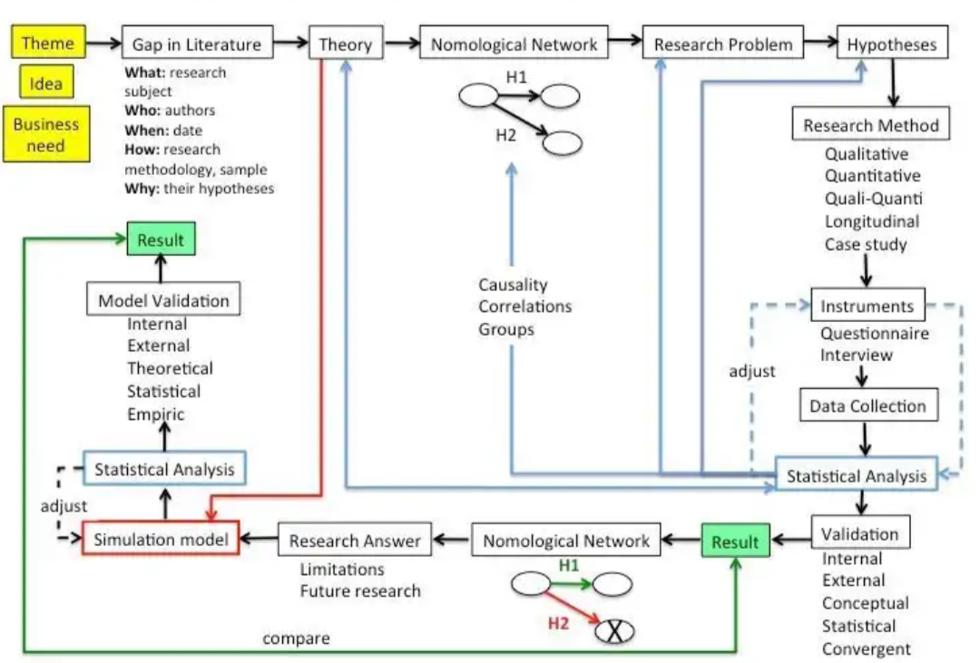
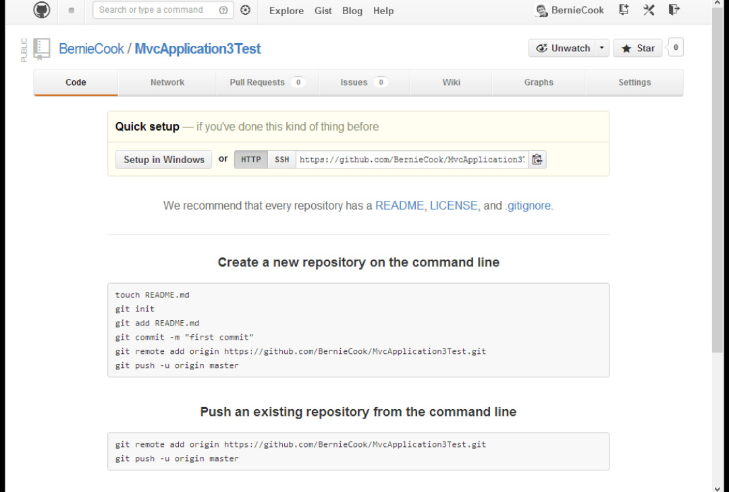
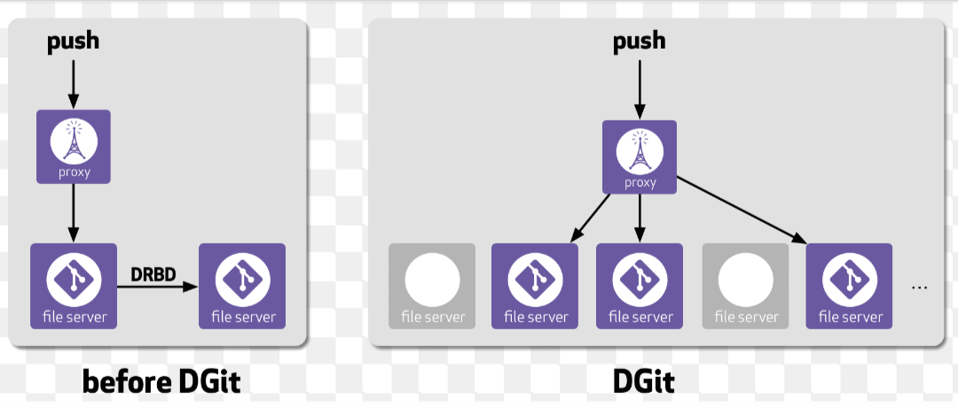
GIT and GITHUB relevant Diagram
Adding Repository
GitHub auto backup projects into servers

Slide 6
History & Current Versions Of GIT
GIT was cfcreated by Linus Travalds.The development of Git began on 3 April 2005 and announced the project on 6 April .It became self-hosting as of 7 April .The first merge of multiple branches took place on 18 April .It was created for development of Linus kernel with other lernel developers constributing to its initial development. Its current maintainer since 2005 is Junio Hamano.
Linus Torvalds has quipped about the name “git”,which is British English slang for a stupid or unpleasant person .The readme File of the source code elaborates further.
The latest (2.18.0)32-bit version of Git for Windows.This is the most recent maintained build It was Released about 2months ago,on 2018-06-22.

